Slide 1

Linear and Logistic Regression
Simple, yet powerful predictors
Yordan Darakchiev
Technical Trainer
iordan93@gmail.com

Slide 2
sli.do #MachineLearning

Slide 3
Table of Contents
Machine learning basics
Objective function, cost function, optimization
Linear regression
Problem description, motivation
Algorithm
Usage
RANSAC
Extensions: polynomial regression
Logistic regression
Problem description
Algorithm
Usage

Slide 4
Linear Regression
Predict continuous values… and torture first-semester students

Slide 5
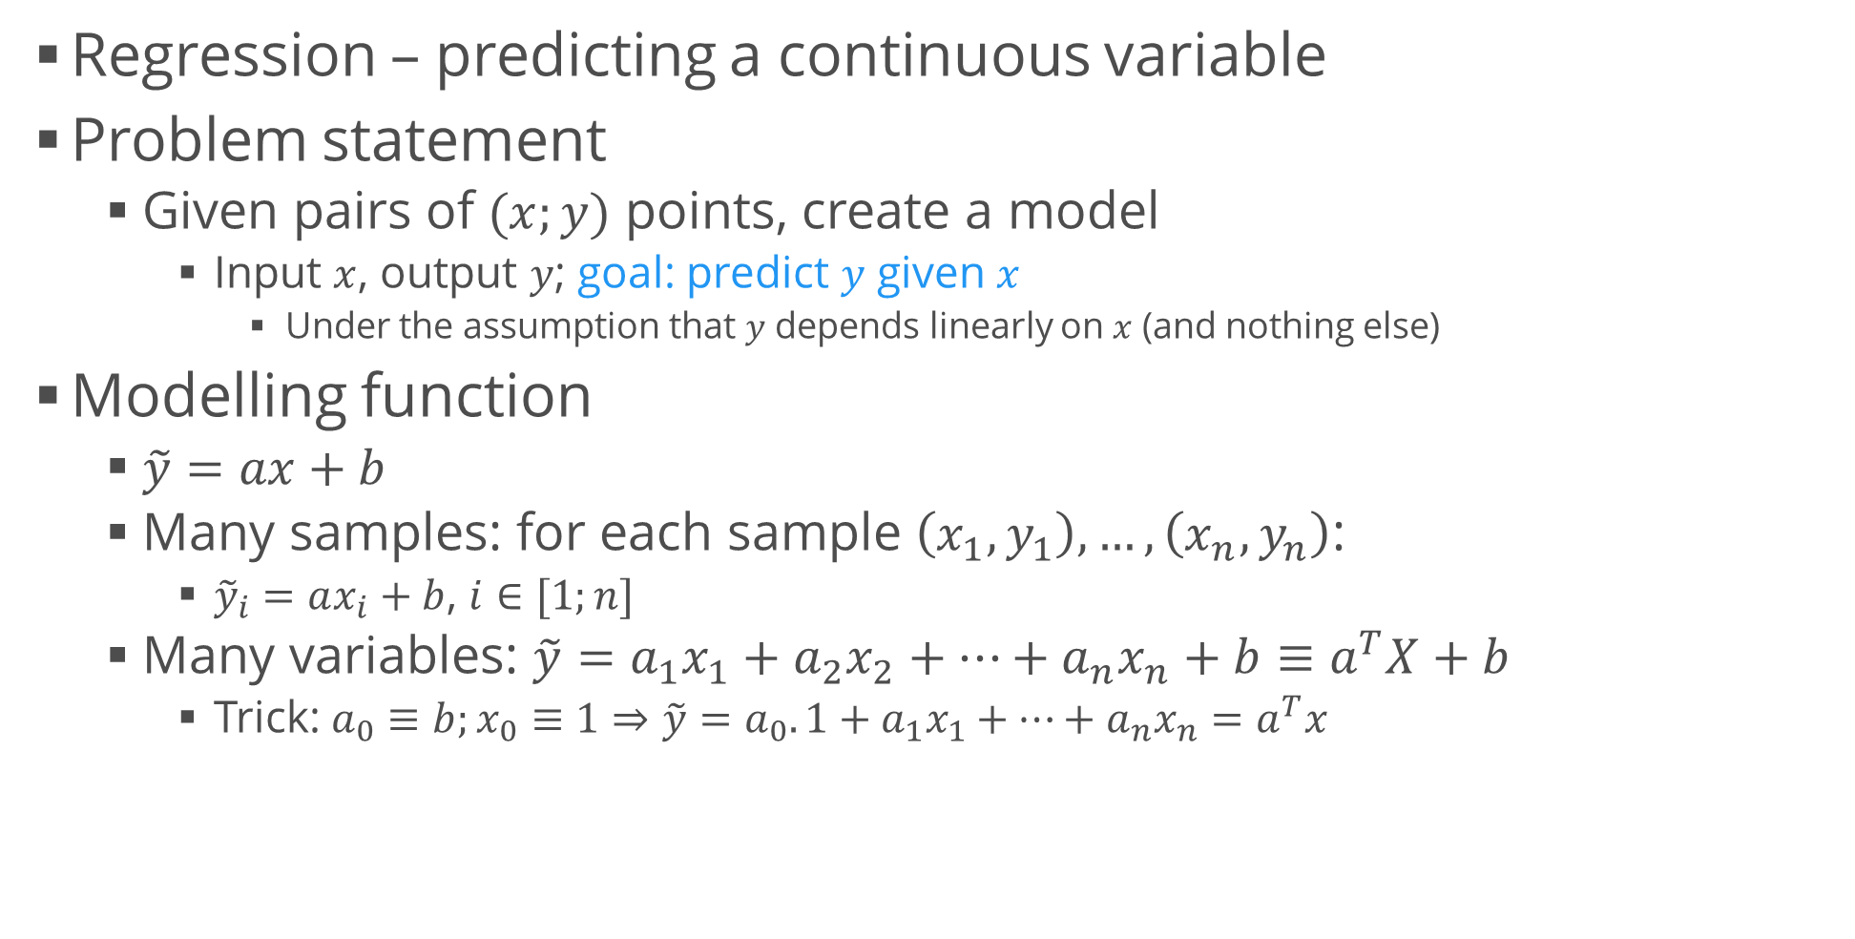
Linear Regression Intuition
Regression – predicting a continuous variable
Problem statement
Given pairs of $(x;y)$ points, create a model
Input $x$, output $y$; goal: predict $y$ given $x$
Under the assumption that $y$ depends linearly on $x$ (and nothing else)
Modelling function
$\tilde{y}=ax+b$
Many samples: for each sample $\left(x_{1},y_{1}\right), …, \left(x_{n}, y_{n}\right)$:
${\tilde{y}}_{i}=ax_{i}+b$, $i∈[1;n]$
Many variables: $\tilde{y}=a_{1}x_{1}+a_{2}x_{2}+…+a_{n}x_{n}+b≡a^{T}X+b$
Trick: $a_{0}≡b;x_{0}≡1⇒\tilde{y}=a_{0}.1+a_{1}x_{1}+…+a_{n}x_{n}=a^{T}x$

Slide 6
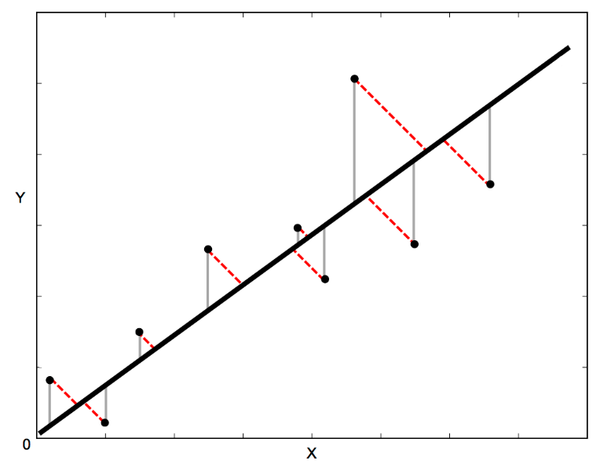
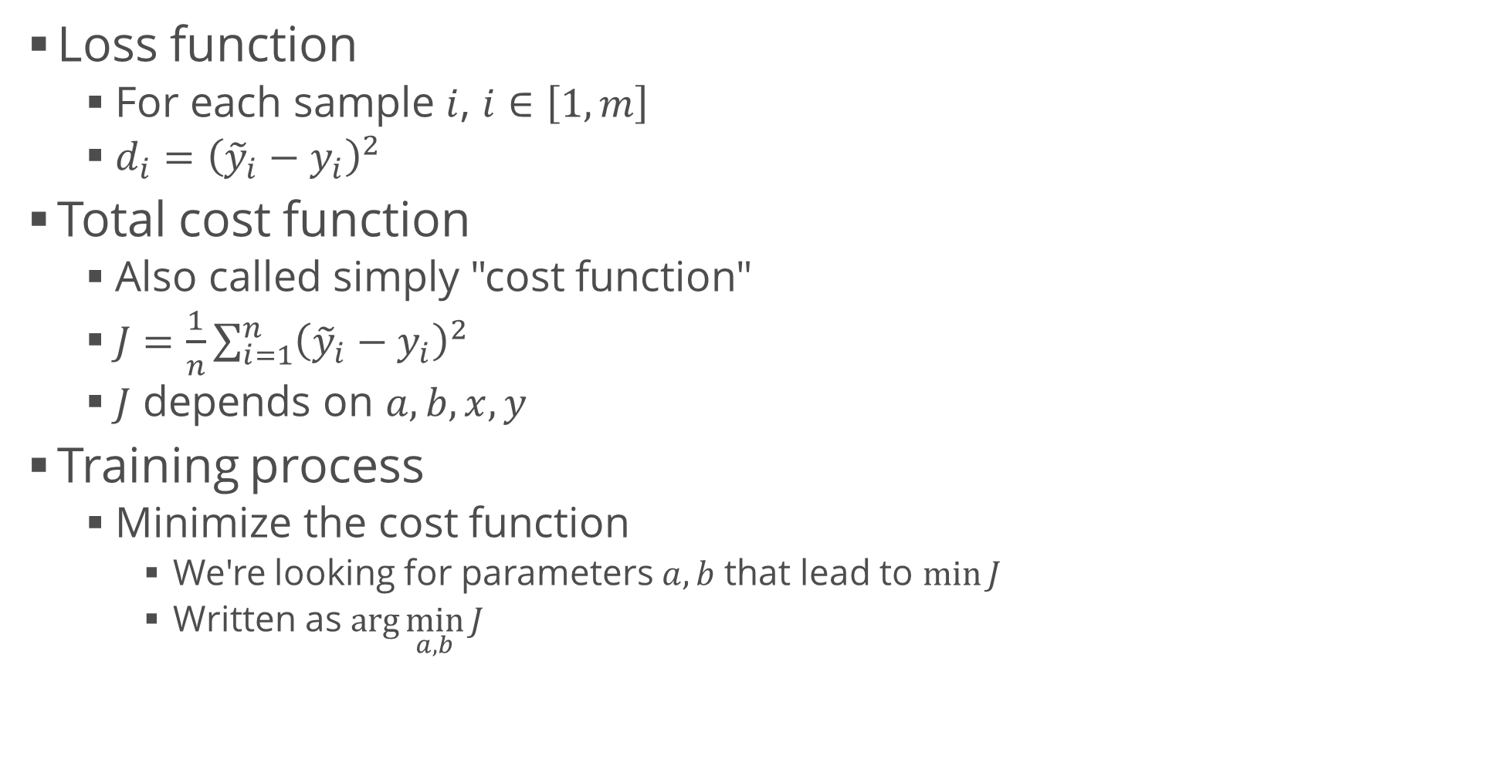
Training
Loss function
For each sample $i$, $i∈\left[1,m\right]$
$d_{i}={\left({\tilde{y}}_{i}−y_{i}\right)}^{2}$
Total cost function
Also called simply "cost function"
$J=\frac{1}{n}\sum_{i=1}^{n}{{\left({\tilde{y}}_{i}−y_{i}\right)}^{2}}$
$J$ depends on $a, b, x, y$
Training process
Minimize the cost function
We're looking for parameters $a,b$ that lead to $\min{J}$
Written as $\arg{\min_{a,b}{J}{ }}$

Slide 7
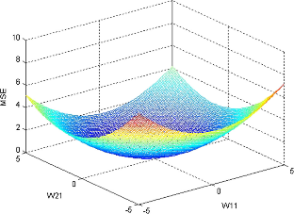
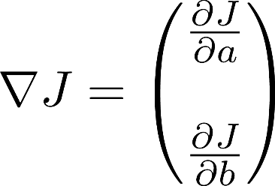
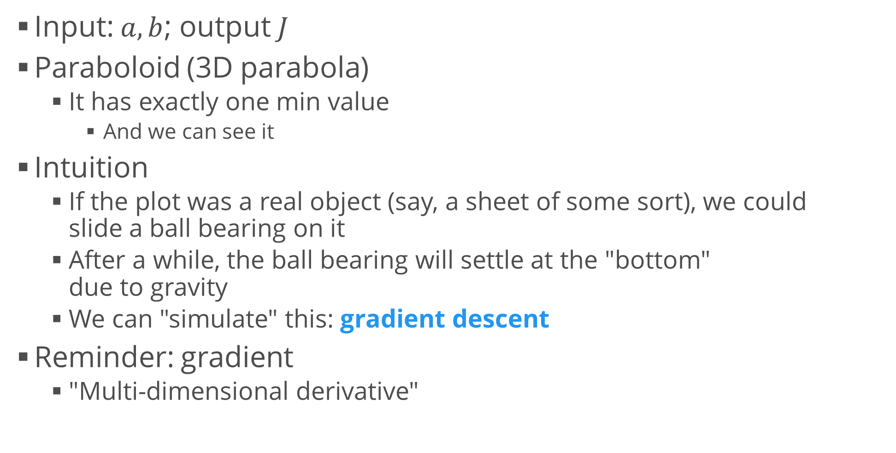
Gradient Descent
Input: $a, b$; output $J$
Paraboloid (3D parabola)
It has exactly one min value
And we can see it
Intuition
If the plot was a real object (say, a sheet of some sort), we could slide a ball bearing on it
After a while, the ball bearing will settle at the "bottom" due to gravity
We can "simulate" this: gradient descent
Reminder: gradient
"Multi-dimensional derivative"

Slide 8
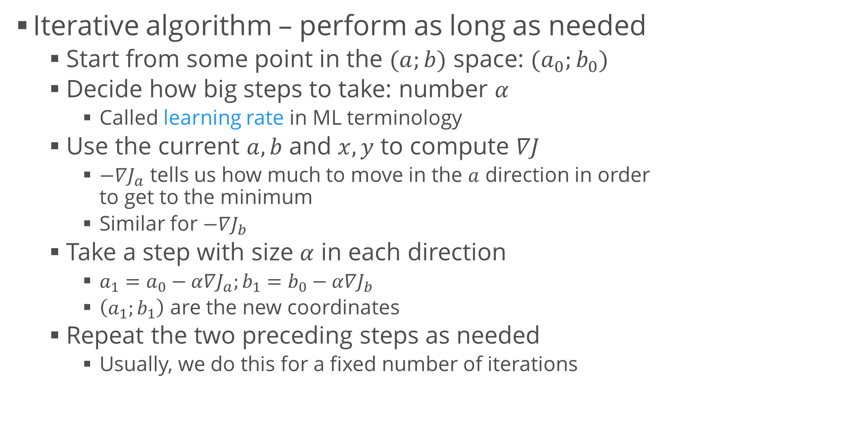
Gradient Descent (2)
Iterative algorithm – perform as long as needed
Start from some point in the $(a;b)$ space: $(a_{0};b_{0})$
Decide how big steps to take: number $α$
Called learning rate in ML terminology
Use the current $a,b$ and $x,y$ to compute $∇J$
$−∇J_{a}$ tells us how much to move in the $a$ direction in order to get to the minimum
Similar for $−∇J_{b}$
Take a step with size $α$ in each direction
$a_{1}=a_{0}−α∇J_{a};b_{1}=b_{0}−α∇J_{b}$
$\left(a_{1};b_{1}\right)$ are the new coordinates
Repeat the two preceding steps as needed
Usually, we do this for a fixed number of iterations

Slide 9
Example: Housing Prices
Multiple linear regression
Many predictor variables
Let's use this model to try and predict housing prices (a classical dataset located here)
First, we want to explore the datasets
A more thorough exploration is "left as an exercise to the reader"
But we want to see what model would be appropriate
In addition to usual data analysis techniques, let's plot all correlations between any pair of features
housing.columns = ["crime_rate", "zoned_land", "industry", "bounds_river", "nox_conc", "rooms", "age", "distance", "highways", "tax", "pt_ratio", "b_estimator", "pop_status", "price"]

Slide 10
Creating a Model
Modelling is very simple
Like in the 2D example
So what?
We might want to predict some prices
Let's just pass some random rows and see the result
Note: Never test on the training dataset!
housing_model = LinearRegression()
predictor_attributes = housing.drop("price", axis = 1)
housing_model.fit(predictor_attributes, housing.price)
print(housing_model.coef_)
print(housing_model.intercept_)
test_houses = housing.sample(10)
predicted = housing_model.predict( test_houses.drop("price", axis = 1))
print(predicted)
print(test_houses.price)

Slide 11
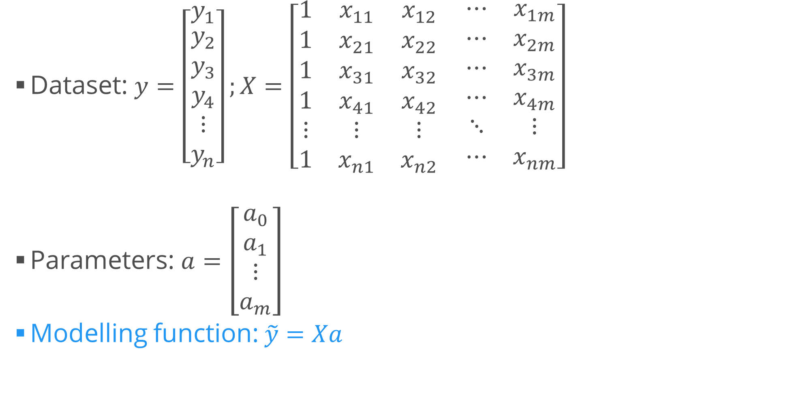
Delving Deeper into Matrices
Dataset: $y=\left[\begin{matrix}y_{1} \\ \begin{aligned}y_{2} \\ y_{3} \\ y_{4}\end{aligned} \\ ⋮ \\ y_{n}\end{matrix}\right];X=\left[\begin{matrix}1 & x_{11} & x_{12} \\ 1 & x_{21} & x_{22} \\ 1 & x_{31} & x_{32} \\ 1 & x_{41} & x_{42} \\ ⋮ & ⋮ & ⋮ \\ 1 & x_{n1} & x_{n2}\end{matrix}\begin{matrix} ⋯ & x_{1m} \\ ⋯ & x_{2m} \\ ⋯ & x_{3m} \\ ⋯ & x_{4m} \\ ⋱ & ⋮ \\ ⋯ & x_{nm}\end{matrix}\right]$
Parameters: $a=\left[\begin{matrix}a_{0} \\ a_{1} \\ \begin{aligned}⋮ \\ a_{m}\end{aligned}\end{matrix}\right]$
Modelling function: $\tilde{y}=Xa$
third observation
second variable

Slide 12
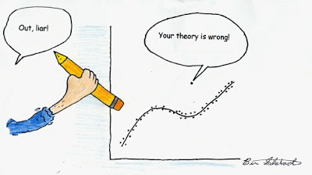
Regression with Outliers
As we saw, the data has outliers
A few points which are far from the others
Our goal is to exclude outliers
There are several methods
One very common – RANSAC (RANdom SAmple Consensus)
Algorithm
Fit a model to a random subsample ("inliers")
Test all data points and include those which are "near" the model
Small enough error, tolerance provided by developer
Fit the model again
Estimate the error of the model (difference between first and second)
Iterate steps 1-4 until performance reaches a threshold or number of iterations

Slide 13
Lab: RANSAC on the Housing Dataset
Usage: similar to the linear regression model
We can also provide parameters, e.g. min number of random samples, max iterations, threshold (to include data points)
We can also provide the type of model we want to perform RANSAC on
Linear regression by default but we may use other regression models
View inliers and outliers
from sklearn.linear_model import RANSACRegressor
ransac = RANSACRegressor()
ransac.fit(housing.drop("price", axis = 1), housing.price)
print(ransac.estimator_.coef_, ransac.estimator_.intercept_)
ransac = RANSACRegressor(LinearRegression(), min_samples = 50, max_trials = 100, residual_threshold = 5.0)
inliers = housing[ransac.inlier_mask_]
outliers = housing[~ransac.inlier_mask_]
plt.scatter(inliers.rooms, inliers.price)
plt.scatter(outliers.rooms, outliers.price)

Slide 14

Polynomial Regression
Extension of the linear regression algorithm
We can use the linear regression algorithm to perform polynomial regression (e.g. fitting a quadratic curve)
Just precompute the columns
Example: if we have columns x, y and z, compute x * z, y * z, x * z and perform linear regression on these 6 features
Example 2: polynomial terms: multiply $x$ by itself: x * x, x * x * x, etc.
This can be achieved easily with scikit-learn
from sklearn.preprocessing import PolynomialFeatures
x = np.arange(6).reshape(3, 2)
poly = PolynomialFeatures(2)
x_transformed = poly.fit_transform(x)
print(poly.get_feature_names())
print(poly.n_input_features_)
print(poly.n_output_features_)
# Now we can perform linear regression with x_transformed as the input

Slide 15
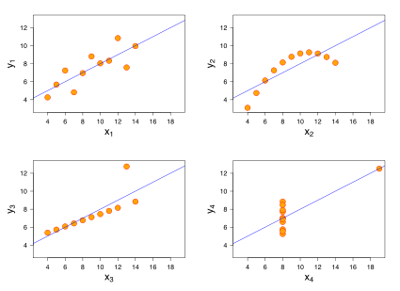
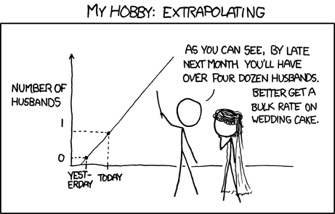
Common Mistakes
There are two main types of errors we can make while trying regression models
Use a wrong model
Anscombe's quartet
Extrapolate without knowing (especially if we have interacting features)

Slide 16
Logistic Regression
Use a regression model to classify

Slide 17
Classification
Predict one of several known classes
Based on the input parameters
Example: classify whether a picture is of a cat or a dog
Regression and classification make up most of the machine learning problems
Choosing an algorithm
"No free lunch": no single algorithm works best
It's best to compare some algorithms to select the best for a particular model
Also, we might want to tune them first
Reminder: ML process
Select features, choose a performance metric (cost function), choose a classifier, evaluate and fine-tune the performance

Slide 18
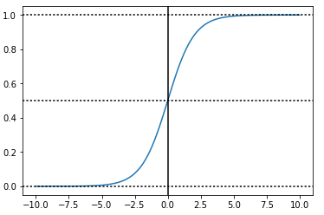
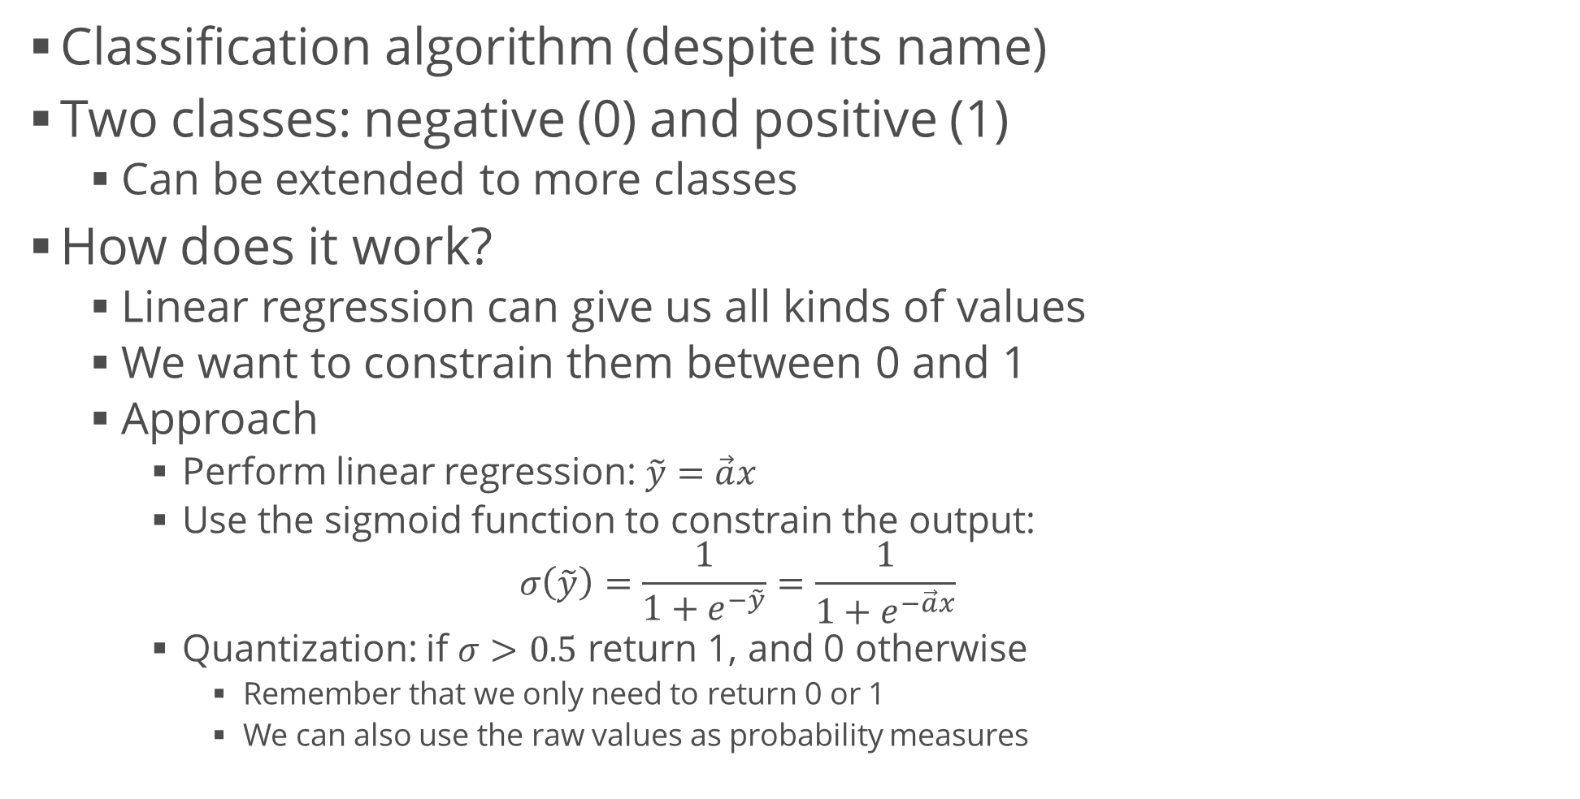
Logistic Regression
Classification algorithm (despite its name)
Two classes: negative (0) and positive (1)
Can be extended to more classes
How does it work?
Linear regression can give us all kinds of values
We want to constrain them between 0 and 1
Approach
Perform linear regression: $\tilde{y}=\vec{a}x$
Use the sigmoid function to constrain the output: $σ\left(\tilde{y}\right)=\frac{1}{1+e^{−\tilde{y}}}=\frac{1}{1+e^{−\vec{a}x}}$
Quantization: if $σ>0.5$ return 1, and 0 otherwise
Remember that we only need to return 0 or 1
We can also use the raw values as probability measures

Slide 19
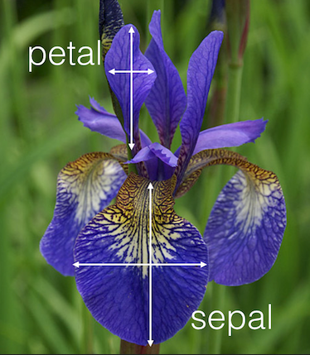

Example: Classifying Iris Flowers
A classic dataset for classification is the Iris dataset
Located here
3 classes (setosa, virginica, versicolor)
4 attributes: petal width / height; sepal width / height (all in cm)
Some features are highly correlated to the class
Explore and inspect the data before modelling

Slide 20
Example: Classifying Iris Flowers (2)
Perform logistic regression
Test (output classes or probabilities)
In the model, there's a "mysterious" parameter C
Regularization: how powerful the data is (more – next time)
A large number means no regularization
We just take the data "as-is", with no other constraints
from sklearn.linear_model import LogisticRegression
model = LogisticRegression(C = 1e6)
model.fit(iris_train_data, iris_train_labels)
print(model.predict(iris_test))
print(model.predict_proba(iris_test))

Slide 21
Many Classes
Two main approaches
One-vs-all: several predictors
One predictor for each class vs. the others
Overall: calculate probabilities of each class
scikit-learn takes care of multiple classes (multinomial logistic regression) by default
We don't even need to transform the labels
This applies to all algorithms in the library

Slide 22
Summary
Machine learning basics
Objective function, cost function, optimization
Linear regression
Problem description, motivation
Algorithm
Usage
RANSAC
Extensions: polynomial regression
Logistic regression
Problem description
Algorithm
Usage

